Slide 1


New ABO
Holistic Journey

Slide 2





New ABO Journey
Supporting new ABOs with a holistic pathway, designed to ensure everyone enjoys the best Amway experience.
Promotion
Learning Solutions
Take advantage of a range of promotions and opportunities, designed to support and boost your business. Discover our START program for new ABOs.
PRODUCTS
The whole journey is supported by dedicated Learning Solutions to help new ABOs and sponsors maximise their business opportunities.
Start your Amway experience by discovering our unique products.
Recognition
Rewards
We are with you every step of the way, and we celebrate your success with our Recognition to Grow incentive!
Rewarding is one of our key pillars, because your success is our success!

Slide 3

Let’s build your business with a strong START!

Slide 4


Be in BUSINESS FOR YOURSELF, but NEVER
BY YOURSELF!

Slide 5


Supporting new ABOs* from their very first step, with a simple and practical program to drive them toward success.
*All new ABOs and Provisional ABOs.

Slide 6

Now
Support First 4 months
START Coupon based on Monthly accumulative PV
Relevant PV brackets fits all ESAN markets
Drive second and future purchases
Support First Order discount
Discount Based on Order PV
One PV threshold for the discount
Only Drive 1st purchase

Slide 7




The New ABO Journey Plan
Your first 4 months from registration
Month 1
Month 2
Month 3
Month 4
Accumulate ≥ 50 and get your first START coupon.
Accumulate ≥ 50 personal PV during the 2nd month to earn more START coupons.
Accumulate ≥ 50 personal PV during the 3rd month to earn more START coupons.
Accumulate ≥ 50 personal PV during the 4th month to earn more START coupons.
Monthly PPV | Coupon Value
≥50 – 99,99 | 1x£20 Start coupon
≥100 – 199,99 | 2x£20 Start coupon (£40)
≥200 | 4x£20 Start coupon (£80)
Monthly PPV | Coupon Value
≥50 – 99,99 | 1x£20 Start coupon
≥100 – 199,99 | 2x£20 Start coupon (£40)
≥200 | 4x£20 Start coupon (£80)
Monthly PPV | Coupon Value
≥50 – 99,99 | 1x£20 Start coupon
≥100 – 199,99 | 2x£20 Start coupon (£40)
≥200 | 4x£20 Start coupon (£80)
Monthly PPV | Coupon Value
≥50 – 99,99 | 1x£20 Start coupon
≥100 – 199,99 | 2x£20 Start coupon (£40)
≥200 | 4x£20 Start coupon (£80)
Subscribe & Save
Products & Solutions
Amway Recurring Orders
Brand Promotions
Free Shipping Promotion
Coupon Redemption
Each START coupon can be redeemed by every 50PV by 28th of the next month.
1x£20 ≥ 50 PV
3x£20 ≥ 150 PV
2x£20 ≥ 100 PV
4x£20 ≥ 200 PV

Slide 8


The New ABO Journey Plan
From month 5 of your Amway journey, you can earn and save £10 for every 100PV
ONGOING
Month 5
Month 6
Month 7
Month 8
Month 9
Month 10
Month 11
Month 12
Personal & Transferable Gift Coupon:
get £10 for each 100 PV
Subscribe & Save
Products & Solutions
Amway Recurring Orders
Brand Promotions
Free Shipping Promotion
Products & Solutions
Brand Promotions
Free Shipping Promotion

Slide 9




We’re always here to offer you
a HELPING HAND during your journey!
How to speed-up your progress toward your goals from the 5th to 12th month after registering.
Taking advantage of Amway’s
new product launches
& special offers.
Benefit from Recurring
Orders and Gift for Growth
coupons.
Sponsor new ABOs and
increase customer sales
More PV earned = more money earned!

Slide 10



Save 480£ in first 12 months
TOTAL SAVINGS
in first 12 months
Up to £320 Start coupons in first 4 months
+
Up to £160
Gift for Growth coupons
based on 200PPV monthly
=
£480
STEP 1
Monthly PPV for a min. of 50 PV to get the 1st, 2nd, 3rd and 4th START coupons.
STEP 2
During months 5th to 12th: for every 100 PV you achieve, you’ll receive a special Gift for Growth coupon worth £10.
Monthly PPV | Coupon Value
≥50 – 99,99 | 1x£20
≥100 – 199,99 | (2x£20) £40
≥200 | (4x£20) £80
Personal
& Transferable Gift Coupon: get £10 for each 100 PV

Slide 11

Learn how START coupons work*
*Income is not guaranteed and may vary depending on business activity, structure or application of Core Plus⁺ incentives.

Slide 12


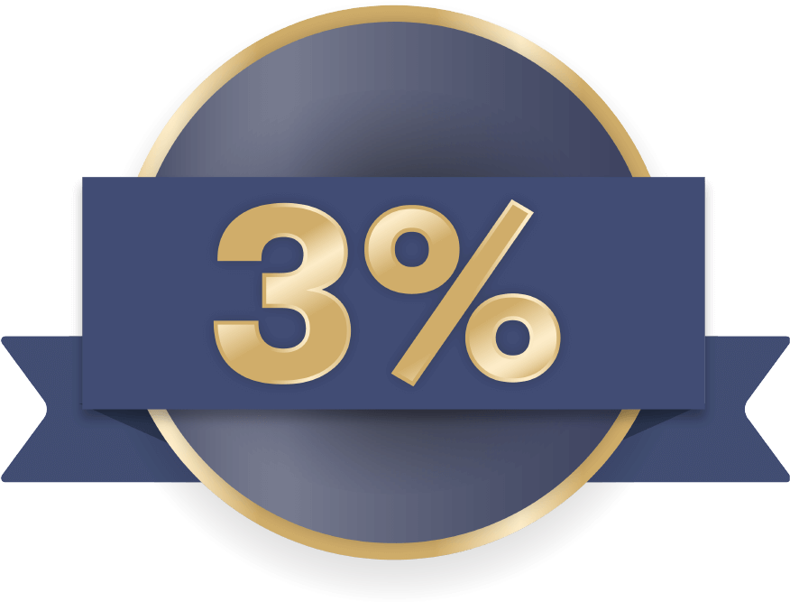
Month 1
Month 2
Ben is a new ABO who joins in June 2024. He places his first order of 200PV and gets 80£ (4x20£) in START coupons to spend in July.
In addition, Ben qualifies for a 3% Performance Bonus* and also earns a future 10€.
In July, Ben continues to discover new products, while also presenting Amway business opportunities to new people.
He registers a new customer who places an order of 50PV.
Placing his personal order of 200PV, he saves £80 and earns £80 in START coupons to spend in August.
From this month, he also starts to earn the Retail Margin, thanks to the RC order.
*on completion of your Certified Retail Consultant orientation
Ben’s personal orders:
200PV = £339
Benefits:
£80 Coupons earned spendable the following month
Bonus Earned:
Performance Bonus 3%* = £10
Ben’s personal orders:
200PV = £339 - £80 Coupons = £259
Monthly Personal PV: 250 (200PV from Ben's orders and 50PV from orders placed by RCs)
Monthly Group PV: 250
Benefits:
£80 Coupons earned spendable the following month (coupons accrued based on the monthly Personal PV)
Bonus Earned:
Performance Bonus 3%* = £13
Retail Margin 20% on Customer Price: £17

Slide 13

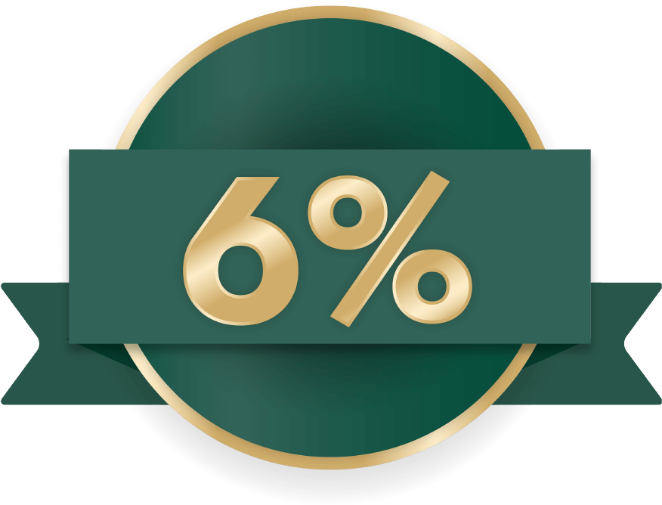
Month 3
Month 4
RC
RC
RC
RC
RC
ABO
RC
ABO
RC
A new ABO decides to start a business with an order of 200PV, who also joins the START program.
Ben registers another new customer who places an order of 50PV in the month.
Ben saves £80 on his order of 200PV, gains £80 in START coupons to spend in September and earns a £49 bonus.
A new customer joined his group, and Ben’s frontline also registered a new customer.
What happens to Ben?
He saves £80 for his order of 200PV, gains £80 in START coupons to spend in October and earns £99 in bonus.
Ben’s personal orders:
200PV = £339- £80 Coupons = £259
Monthly Personal PV: 300 (200PV from Ben's orders and 100PV from orders placed by RCs)
Monthly Group PV: 500
Benefits:
£80 Coupons earned spendable the following month (coupons accrued based on the monthly Personal PV)
Bonus Earned:
Performance Bonus 3% = £15
Retail Margin 20% on Customer Price: £34
TOTAL INCOME: £49
Ben’s personal orders:
200PV = £339 - £80 Coupons = £259
Monthly Personal PV: 350 (200PV from Ben's orders and 150PV from orders placed by RCs)
Monthly Group PV: 600
Benefits:
£80 Coupons earned spendable the following month (coupons accrued based on the monthly Personal PV)
Bonus Earned:
Performance Bonus 6% = £48
Retail Margin 20% on Customer Price: £51
TOTAL INCOME: £99

Slide 14

Further incentives from Month 5
of your Amway Journey*
*Income is not guaranteed and may vary depending on business activity, structure or application of Core Plus⁺ incentives.

Slide 15
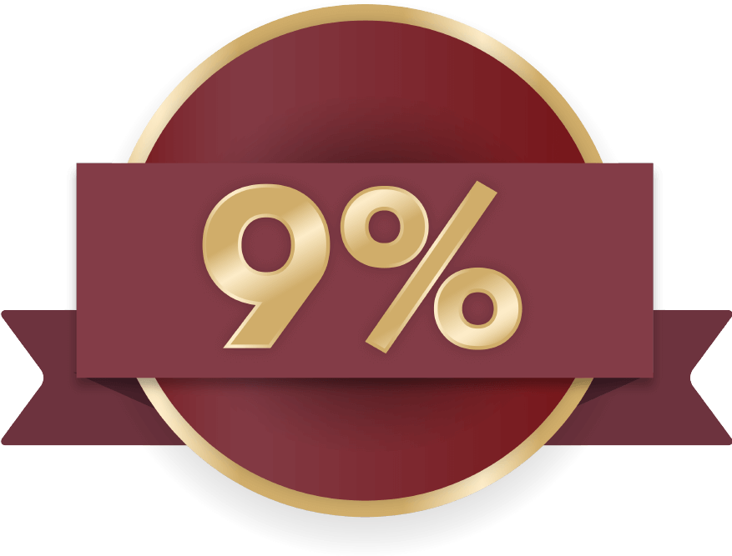
RC
Month 5
Month 6
RC
RC
ABO
RC
ABO
RC
ABO
RC
RC
ABO
ABO
RC
RC
RC
ABO
RC
New ABOs and customers join Ben’s team. Ben qualifies 6% performance bonus.
What happens to Ben?
He saves £80 for his order of 200PV, gains £30 in Gift for Growth coupons (2 coupon of £10 from his personal order and 1x£10 from the order of his customers) to spend in November and earns £112 in bonus.
Ben qualifies the 9% performance bonus, and he is also eligible for Bronze Foundation Incentive⁺ that give to him a 30% more on his performance bonus.
What happens to Ben?
He saves £20 in his order of 200PV, gains £30 in Gift for Growth coupons to spend in December and earns £246 meaning more than double than the month before.
Ben’s personal orders:
200PV = £339 - £80 Coupons = £259
Monthly Personal PV: 350 (200PV from Ben's orders and 150PV from orders placed by RCs)
Monthly Group PV: 850
Benefits:
£30 Coupons earned spendable the following month (coupons accrued based on the monthly Personal PV)
Bonus Earned:
Performance Bonus 6% = £61
Retail Margin 20% on Customer Price: £51
TOTAL INCOME: £112
Ben’s personal orders:
200PV = £339 - £20 Coupons = £319
Monthly Personal PV: 350 (200PV from Ben's orders and 150PV from orders placed by RCs)
Monthly Group PV: 1.300
Benefits:
£30 Coupons earned spendable the following month (coupons accrued based on the monthly Personal PV)
Bonus Earned:
Performance Bonus 9% = £150
Retail Margin 20% on Customer Price: £51
Bronze Foundation 30% on Perf. Bon.: £45
TOTAL INCOME: £246

Slide 16

Make Bronze your next goal

Slide 17

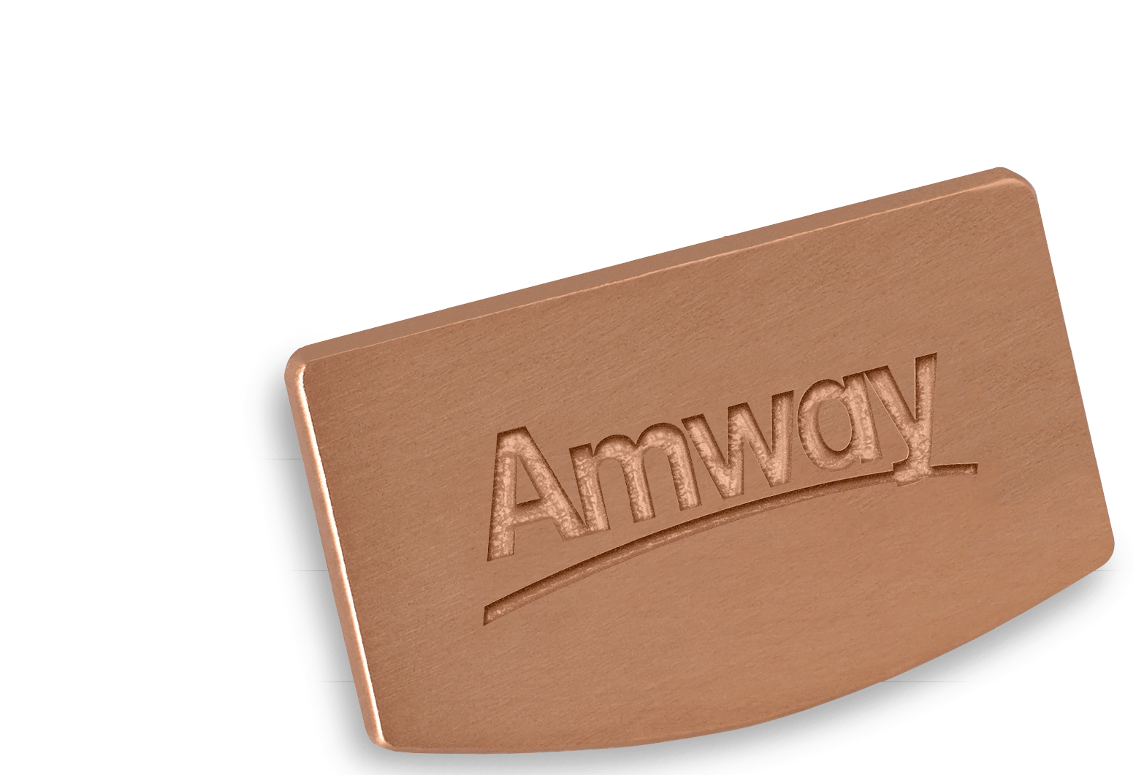
INCREASE your Performance Bonus by 30% and 40% with
the Bronze Incentives⁺! Simply meet the requirements below:
Bronze Foundation Incentive⁺
9% Level
3 legs at 3%
100 PPV
Bronze Builder Incentive⁺
15% Level
3 legs at 6%
100 PPV
+30%
+40%
By focusing on the development of 3 strong legs, the Bronze Incentives⁺ offer immediate rewards, while paving the way for long-term success!
Together with the Bronze Builder Incentive⁺, you will receive your first award: the Bronze PIN!

Slide 18
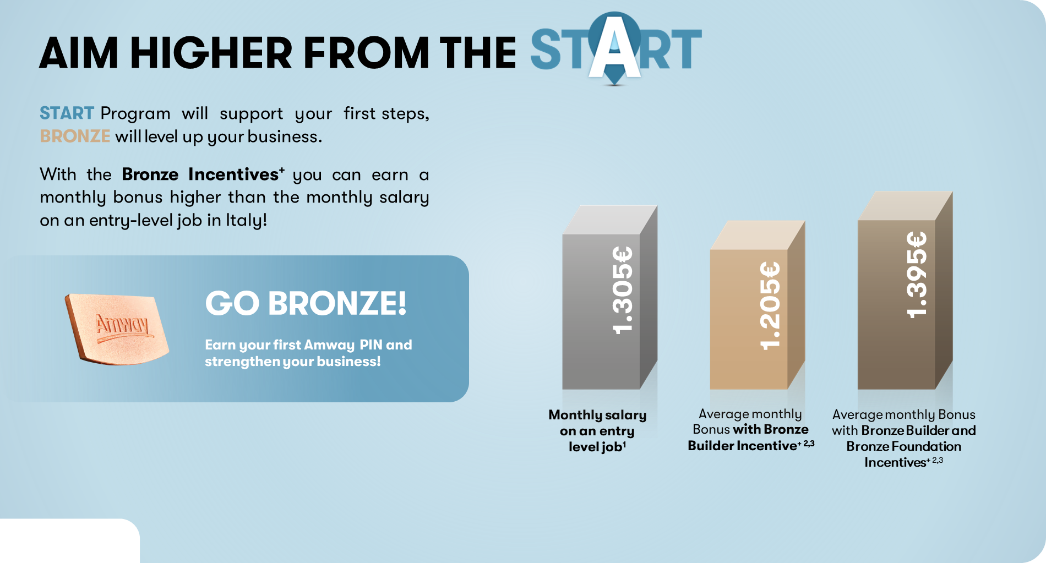
Learn more on
www.amway.co.uk/about-amway/bronze-incentives
¹ 7o Livello contrattuale del CCNL per i dipendenti dalle aziende del terziario, della distribuzione e dei servizi ‘ CONFCOMMERCIO. Archivio nazionale dei contratti collettivi di lavoro. Data from January 2024. I ²This represents the average of all Performance Bonuses and Bronze Incentives⁺ across all months where bronze earnings were received in PY23. I ³ Income may vary depending on business activity, structure or application of Core Plus⁺ incentives. I All the figures given are gross.

Slide 19

Let’s Celebrate:
Recognition to Grow

Slide 20

Amway is committed to providing meaningful recognition experiences at all levels, celebrating every achievement.
Happiness is best achieved through success. This is why
Amway rewards what you achieve, and also what you
help others achieve.

Slide 21


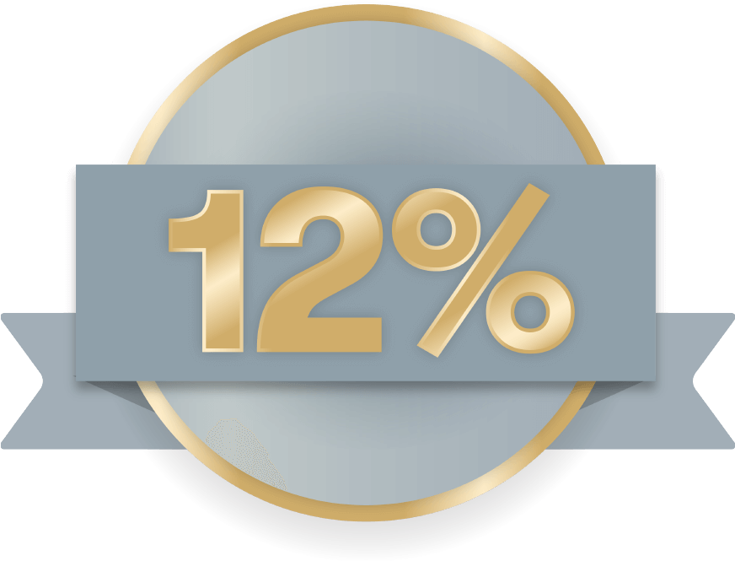
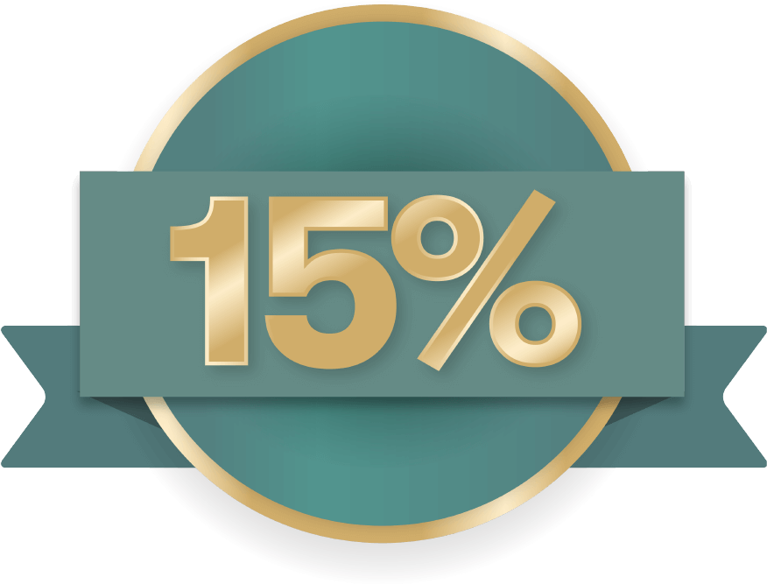
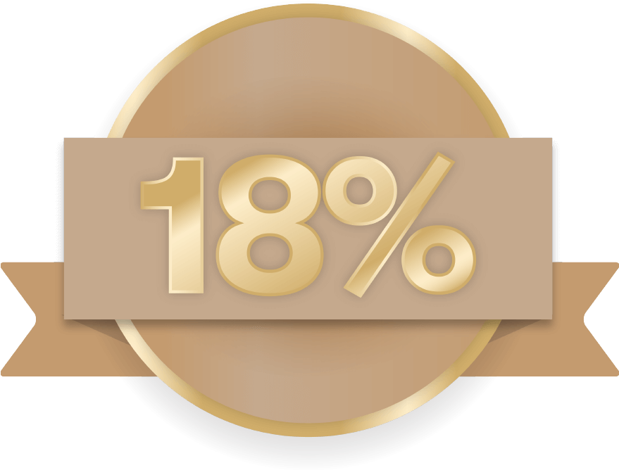
Recognising Success!
Amway is launching a holistic Recognition strategy from December 2023 which focuses on lower levels – 3% to 18% levels and Bronze!
CERTIFICATE
CELEBRATE
GET MORE
Europe in 2023, ANZ, SA, UA to follow in 2024

Slide 22

Recognition to Grow Strategy ESAN
From 3% to 18%, including Bronze Builder and Bronze Builder Consistency Incentives⁺
1
Congratulations
Certificate
To 3% up to 18% Achievers, including Bronze Builder and Bronze Builder Consistency Achievers.
Congratulations on the achievement in certificate format by e-mail.
Links to digital resources to be used on social media channels.
2
Motivational Email Level Up
Achievers who are close to reaching 6%, 9%, 12%, 15% or 18%.
They will be informed and supported to reach their next level.
3
Platinum
Notification
Platinum uplines.
Platinums are informed about Achievers and those who are close to the next level, so they can congratulate and support them appropriately.
3 email campaigns

Slide 23

Take advantage of the opportunity
to boost your business and be ready for more!

